Slide 1
EE230 – Final Project
1.9 GHz CP PLL Design
(using 45nm CMOS Technology)
SUKRUTH

Slide 2
Overview
Project Target
Matlab Simulations
VerilogA Simulations
PLL Circuits
PFD
Charge Pump
Loop Filter
VCO
LC tank
Current-Starved Ring
e. Divider
System Simulations
Corner Simulations
Summary

Slide 3
(1)
Project Target

Slide 4
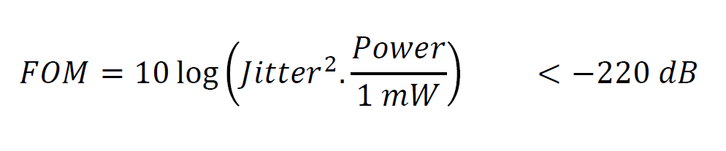
Target

Slide 5
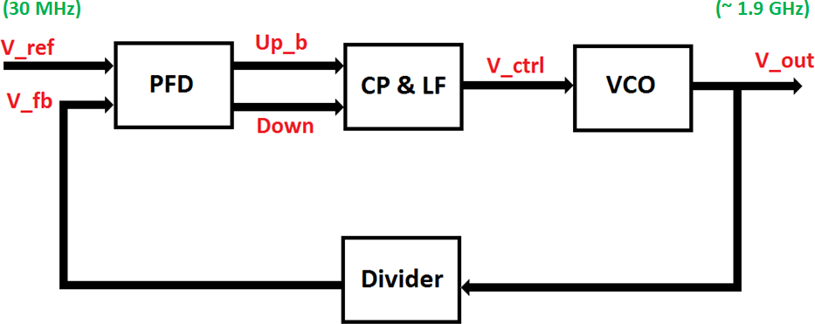
PLL Block Diagram

Slide 6
(2)
Matlab Simulations

Slide 7
System Parameters
Parameter | Value
^{F}REF | 30 MHz
^{F}OUT | 1.9 GHz
^{M}Divider | 64
^{I}CP | 100 uA
^{K}VCO | 600 MHz/V
R_{P} | 6.5 KΩ
C_{P} | 100 fF
C₂ | 10 fF

Slide 8
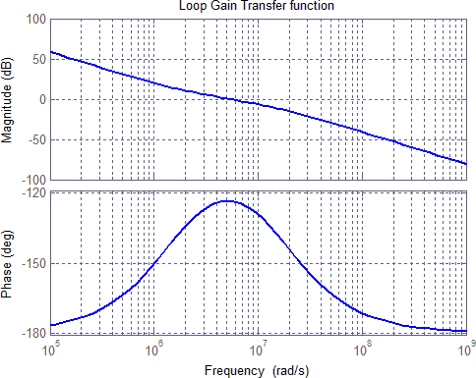
Open-Loop Bode Plots

Slide 9
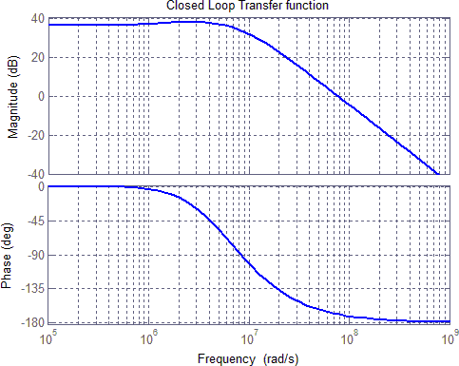
Closed-Loop Bode Plots

Slide 10
Bode Plot Parameters
Parameter |  | Value
Zero | f_{z} | 0.245 MHz
Unity-Gain BW | ^{f}ugb | 0.871 MHz
Pole | ^{f}p3 | 2.693 MHz
Max Phase Margin | ^{PM}Max | 56.44°
Phase Margin | PM | 56.38°
Closed-Loop BW | BW | 1.41 MHz

Slide 11
(3)
VerilogA Simulations

Slide 12
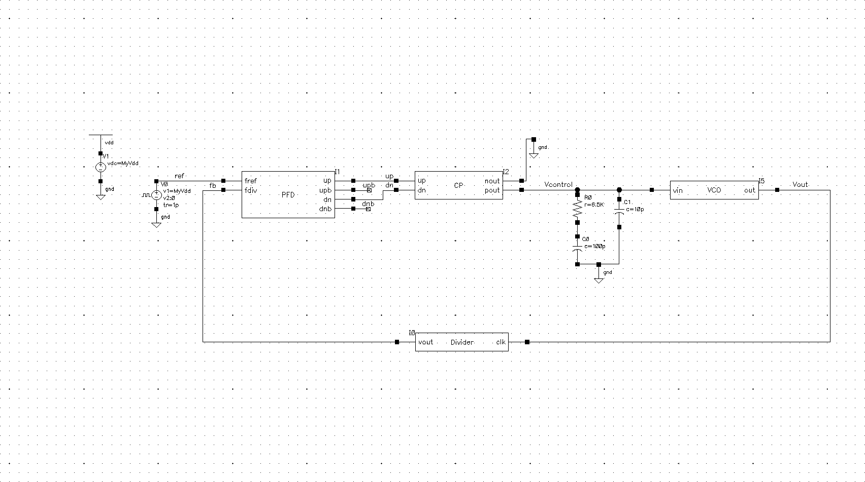
Test Bench

Slide 13
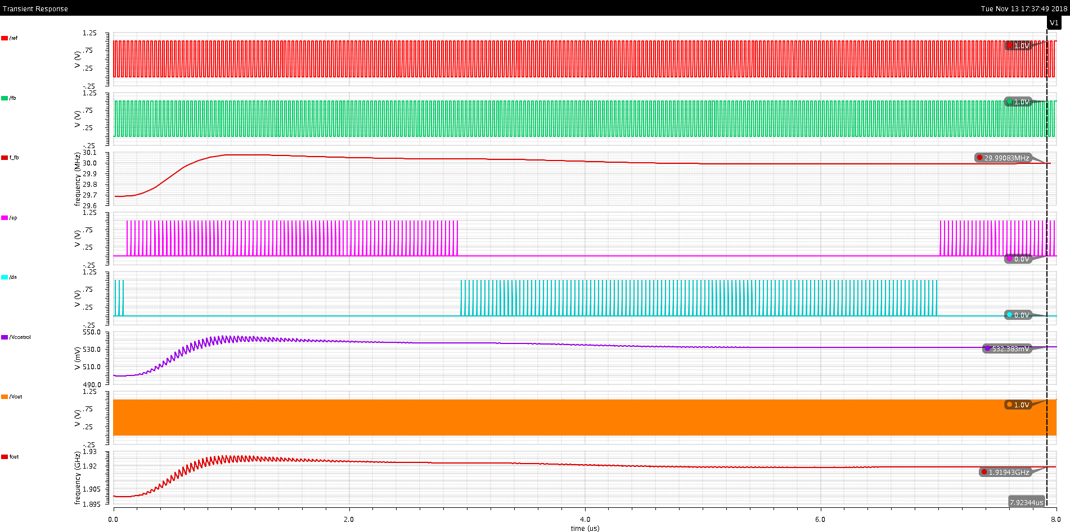
Waveforms
Ref
Fb
Freq_Fb Up Dn
Vcontrol VCO_out Freq_out

Slide 14
(4)
PLL Circuits

Slide 15
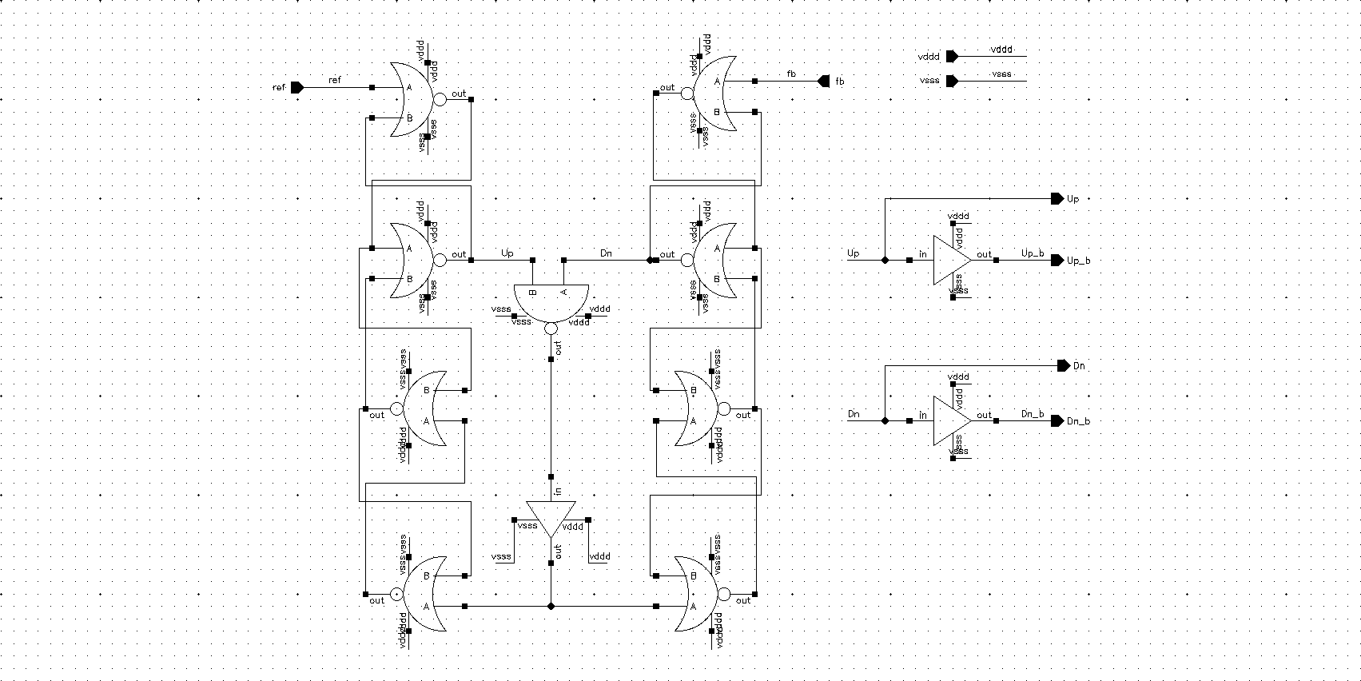
1- PFD

Slide 16
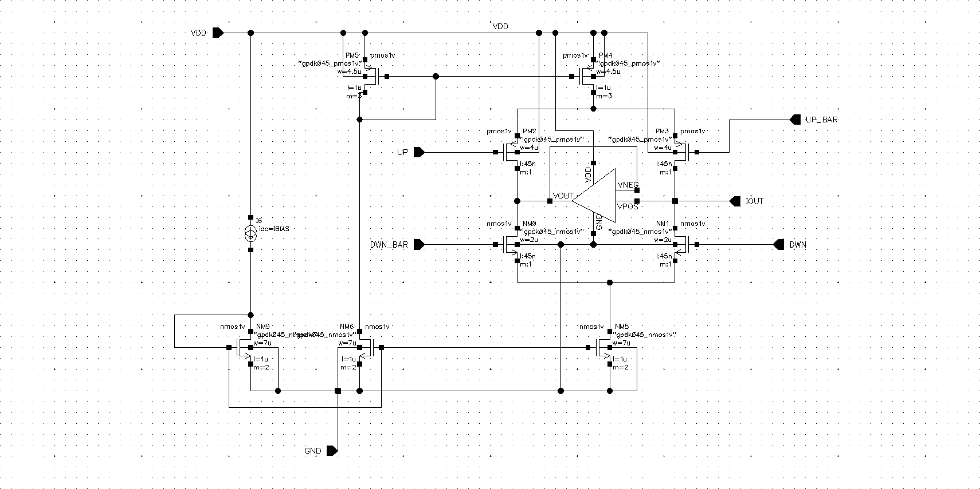
2- Charge Pump

Slide 17
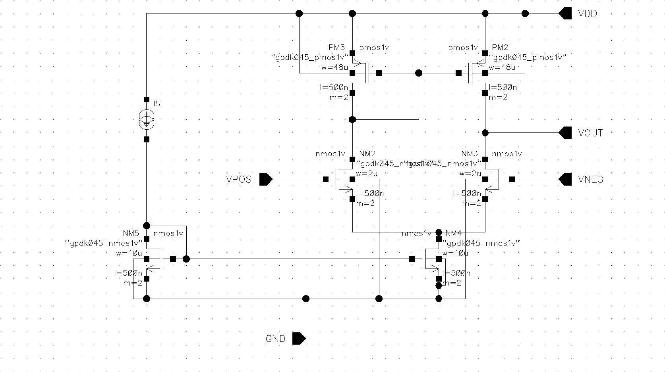
2- Charge Pump
OpAmp

Slide 18
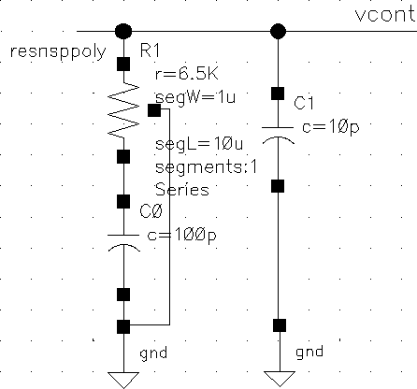
3- Loop Filter

Slide 19
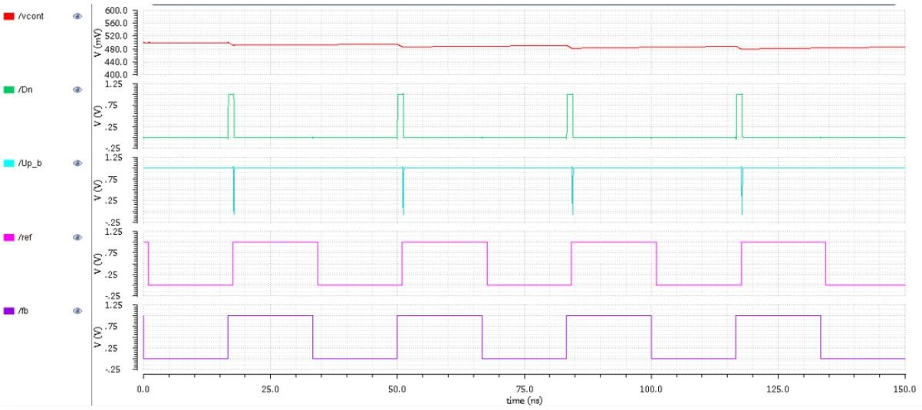
PFD/CP
Vcontrol
Dn
Up_Bar
Ref
Feedback
Reference lagging by 1ns

Slide 20
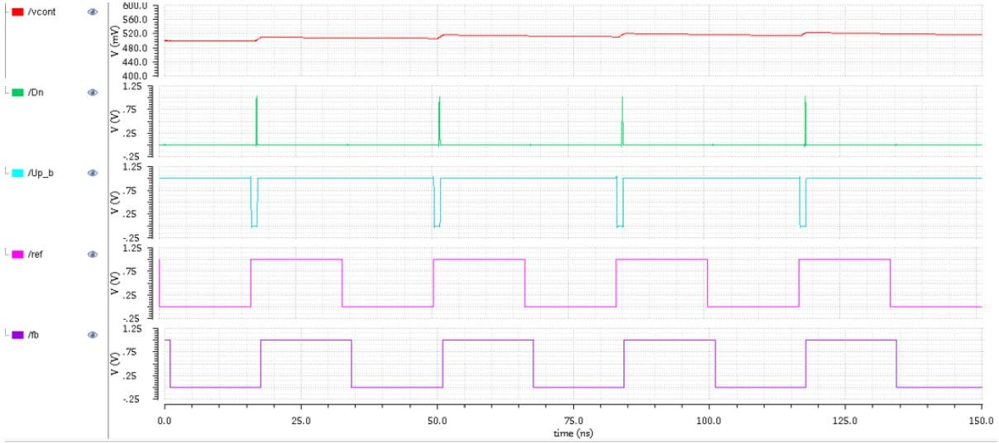
PFD/CP
Vcontrol
Dn
Up_Bar
Ref
Feedback
Reference leading by 1ns

Slide 21
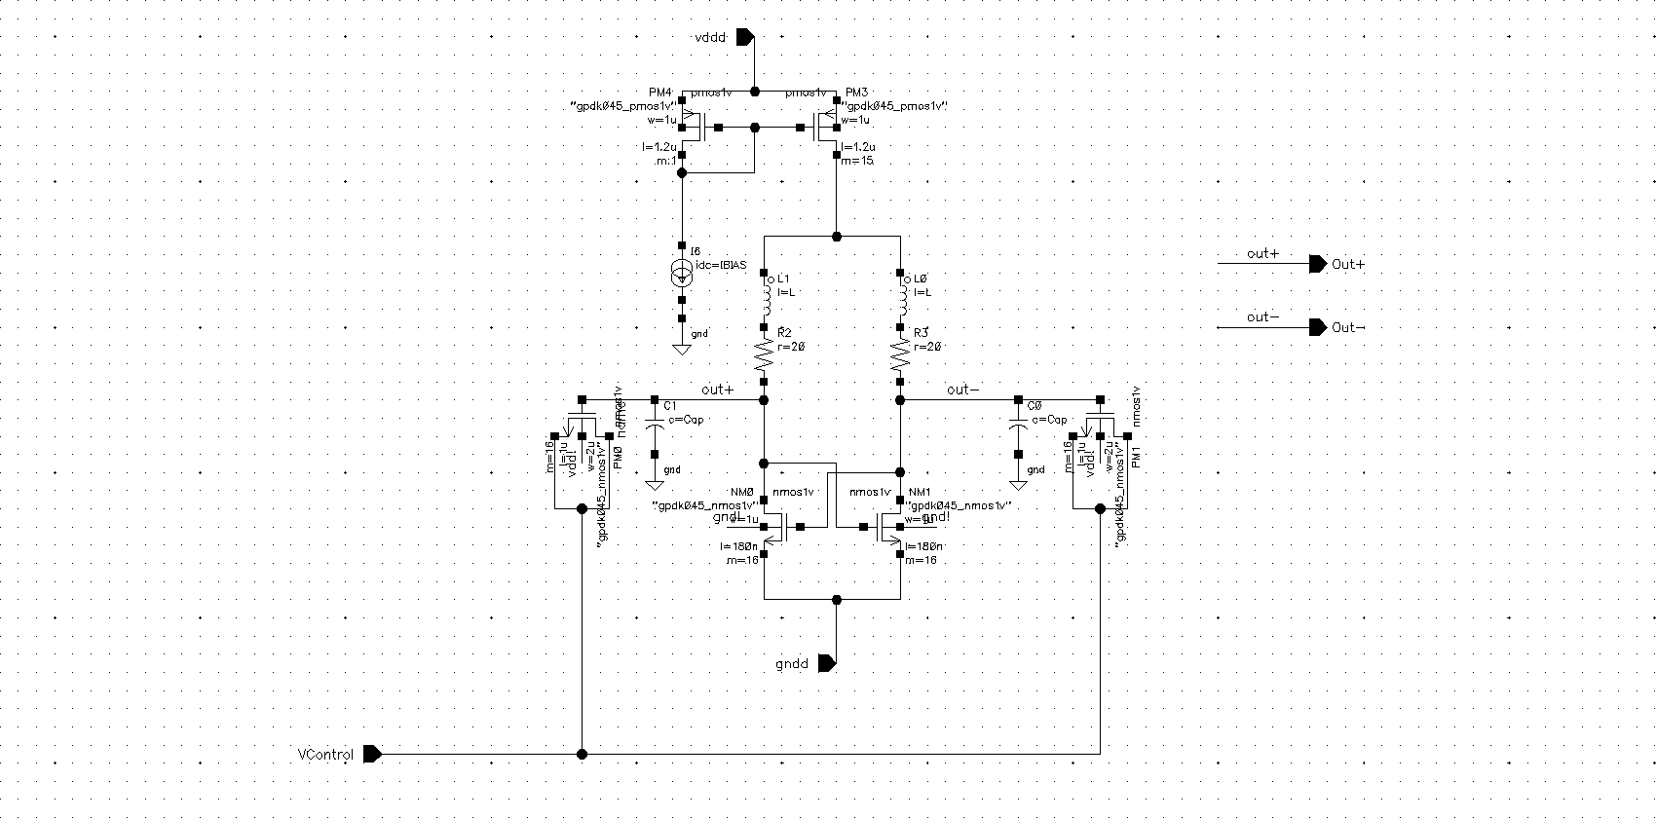
4- VCO
a) LC VCO

Slide 22
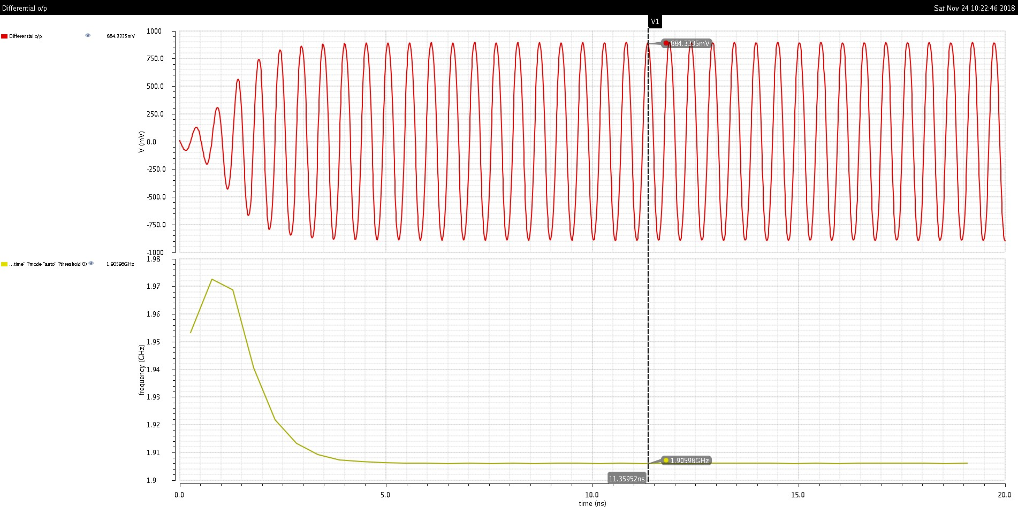
LC Oscillator
VCO_Out
VCO_Freq

Slide 23
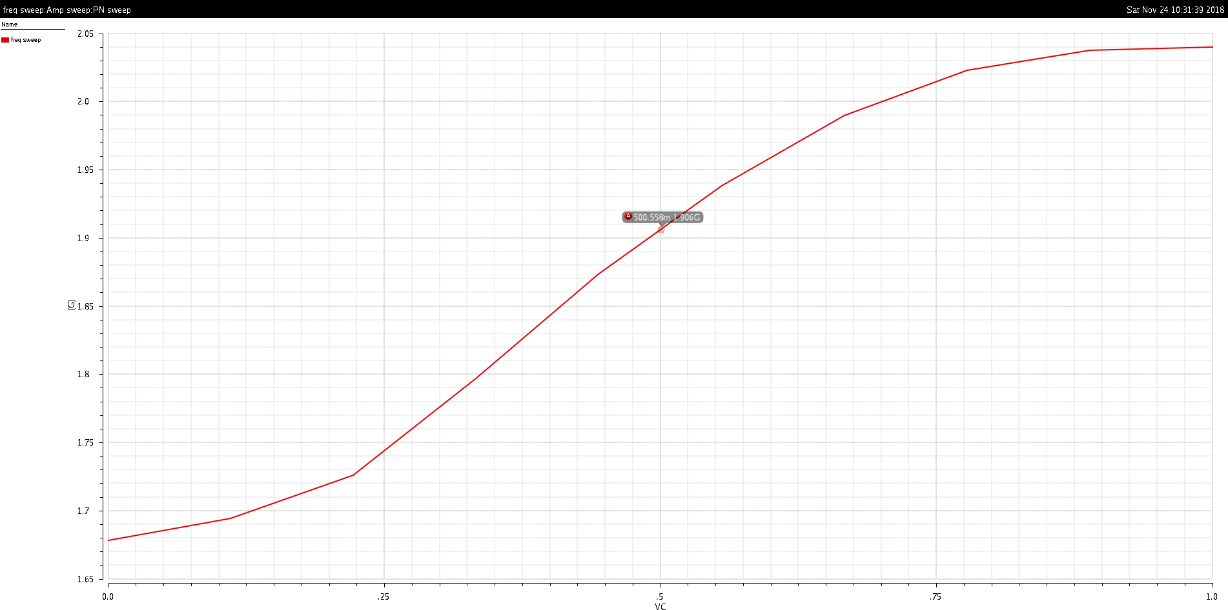
LC Oscillator
VCO_Freq sweep
Vcontrol Tuning Range

Slide 24
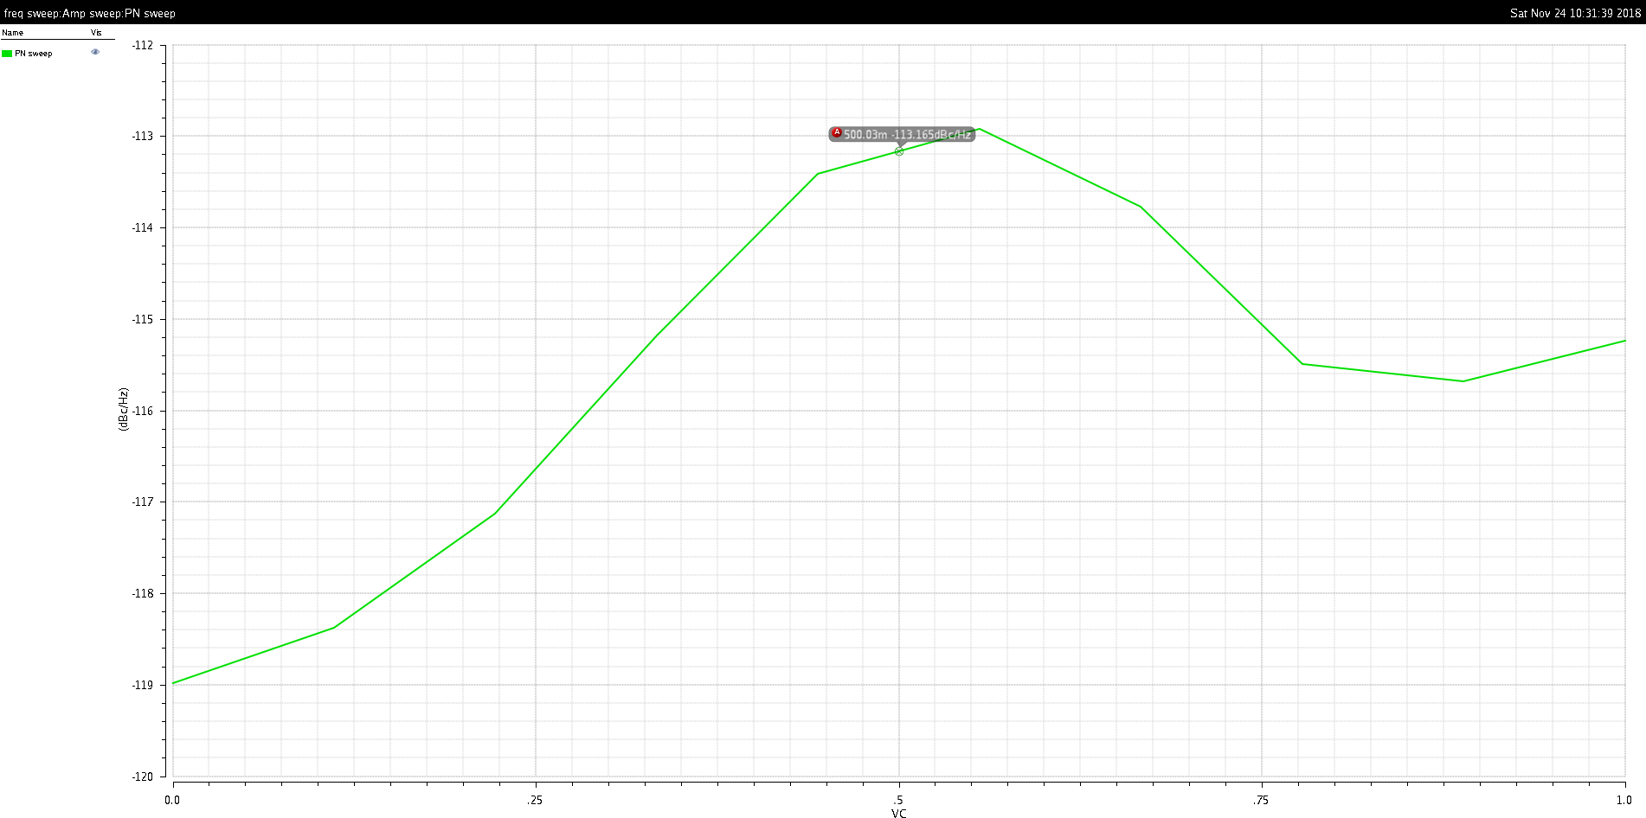
LC Oscillator
Phase
Noise
Phase Noise at 1MHz Offset

Slide 25
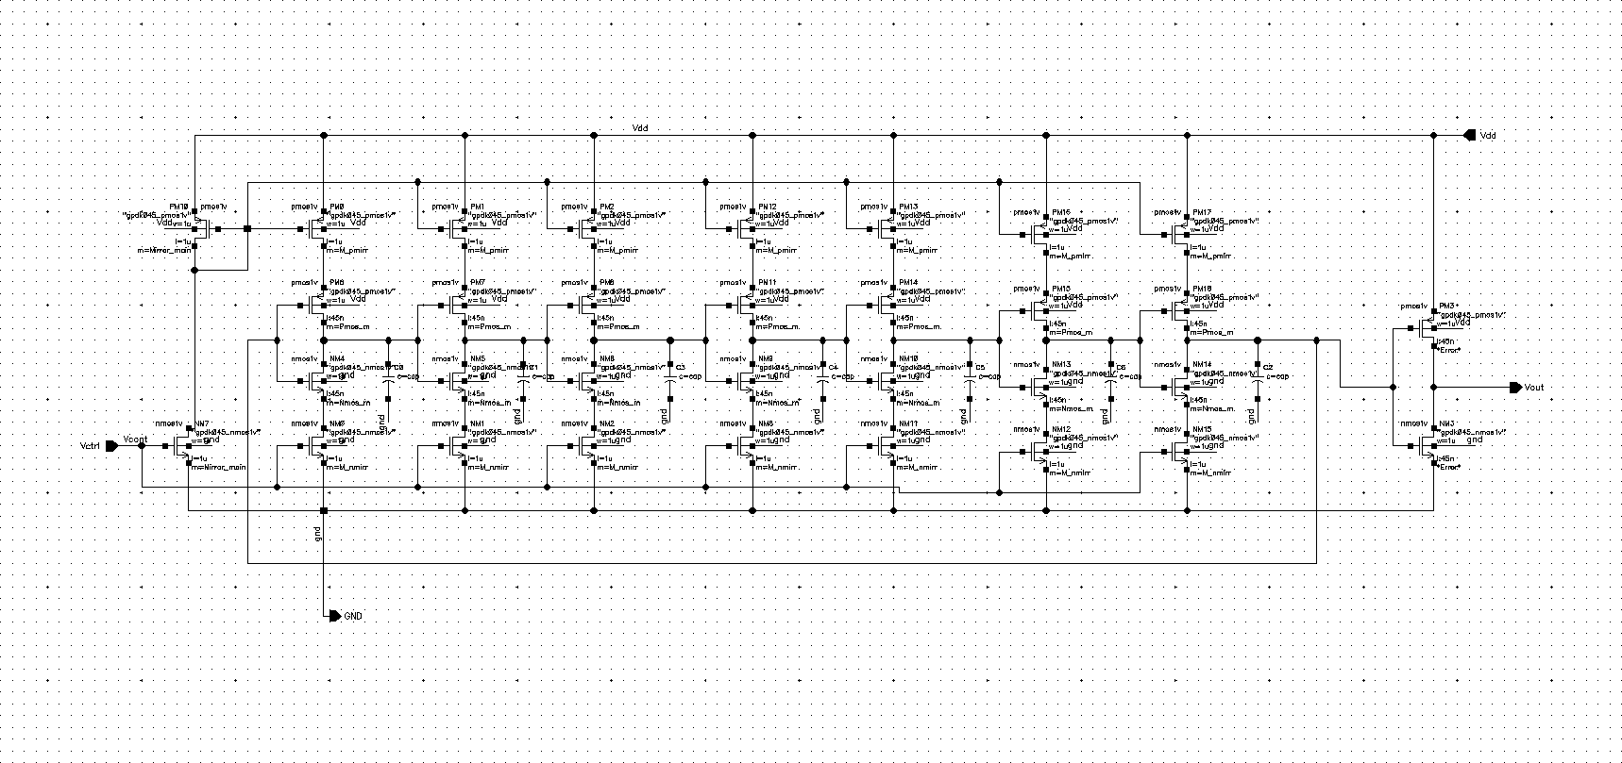
4- VCO
b) Current Starved Ring VCO
Inverter stages

Slide 26
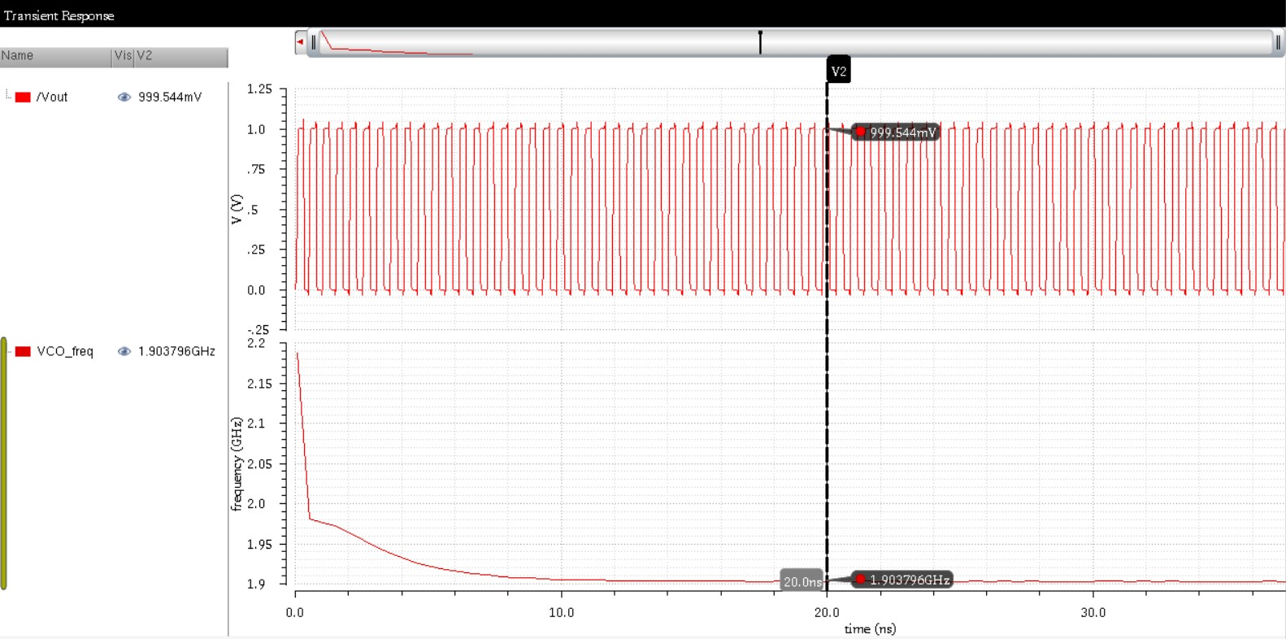
Current Starved Ring Oscillator
VCO_Out
VCO_Freq

Slide 27
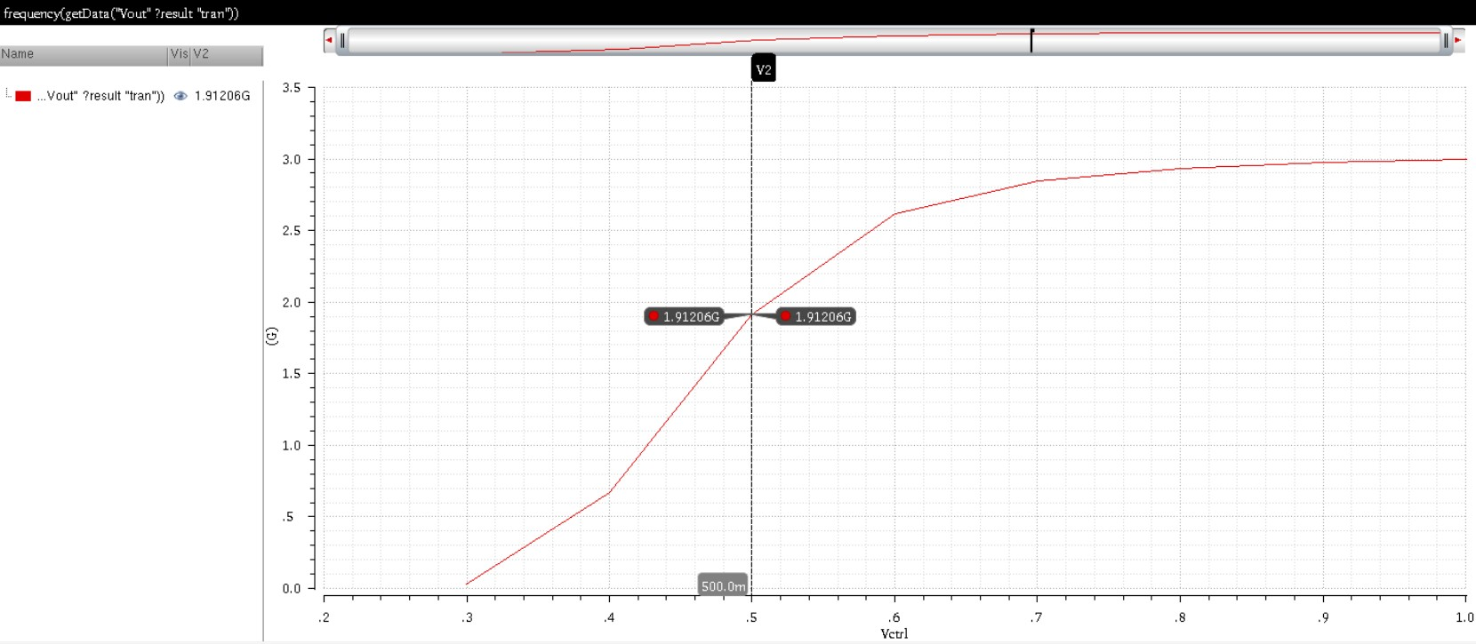
Current Starved Ring Oscillator
VCO_Freq sweep
Vcontrol Tuning Range

Slide 28
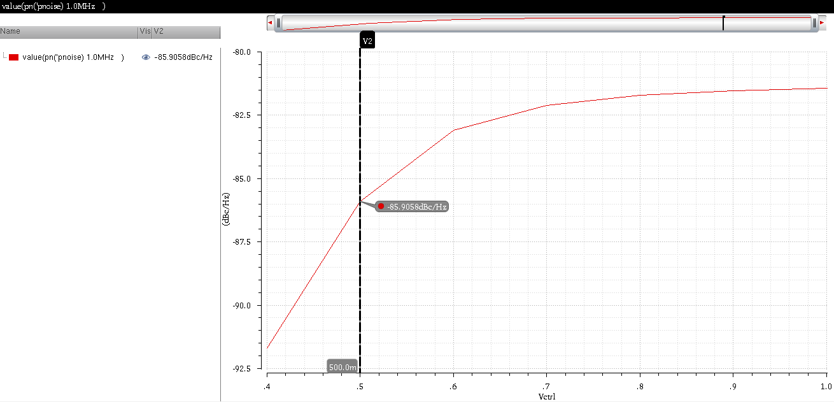
Current Starved Ring Oscillator
Phase
Noise
Phase Noise at 1MHz Offset

Slide 29
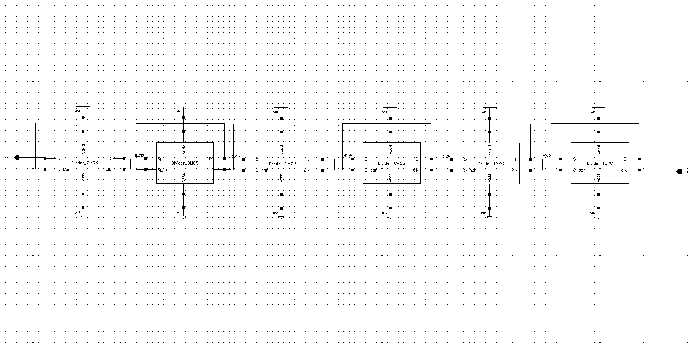
5- Divider
Divide-by-64
(6 Divide-by-2 blocks)
CMOS
TSPC

Slide 30
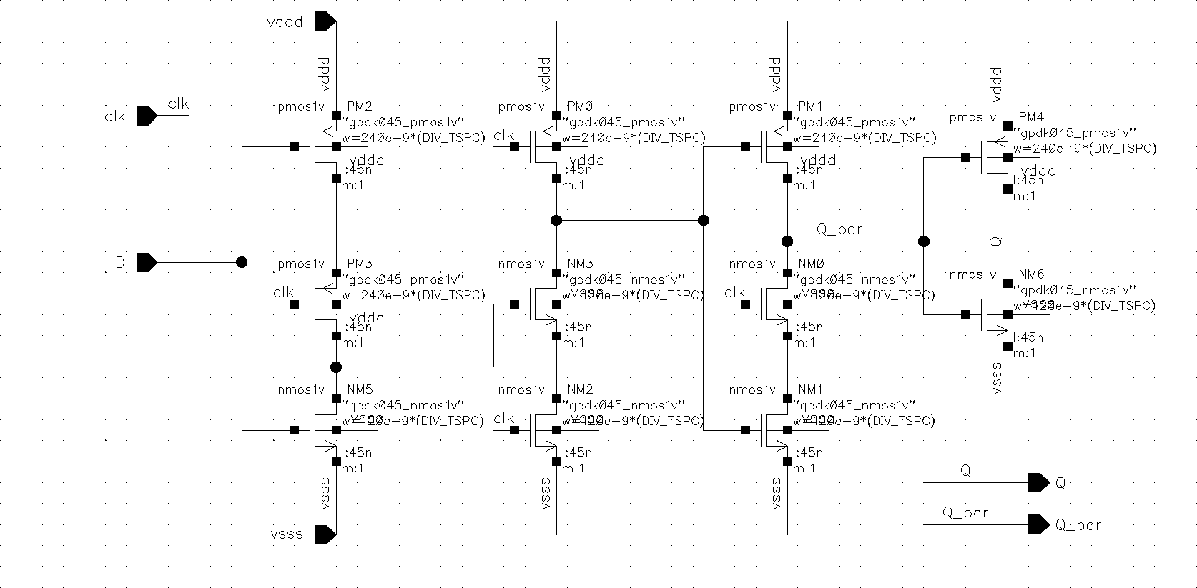
5- Divider
a) TSPC Flipflop

Slide 31
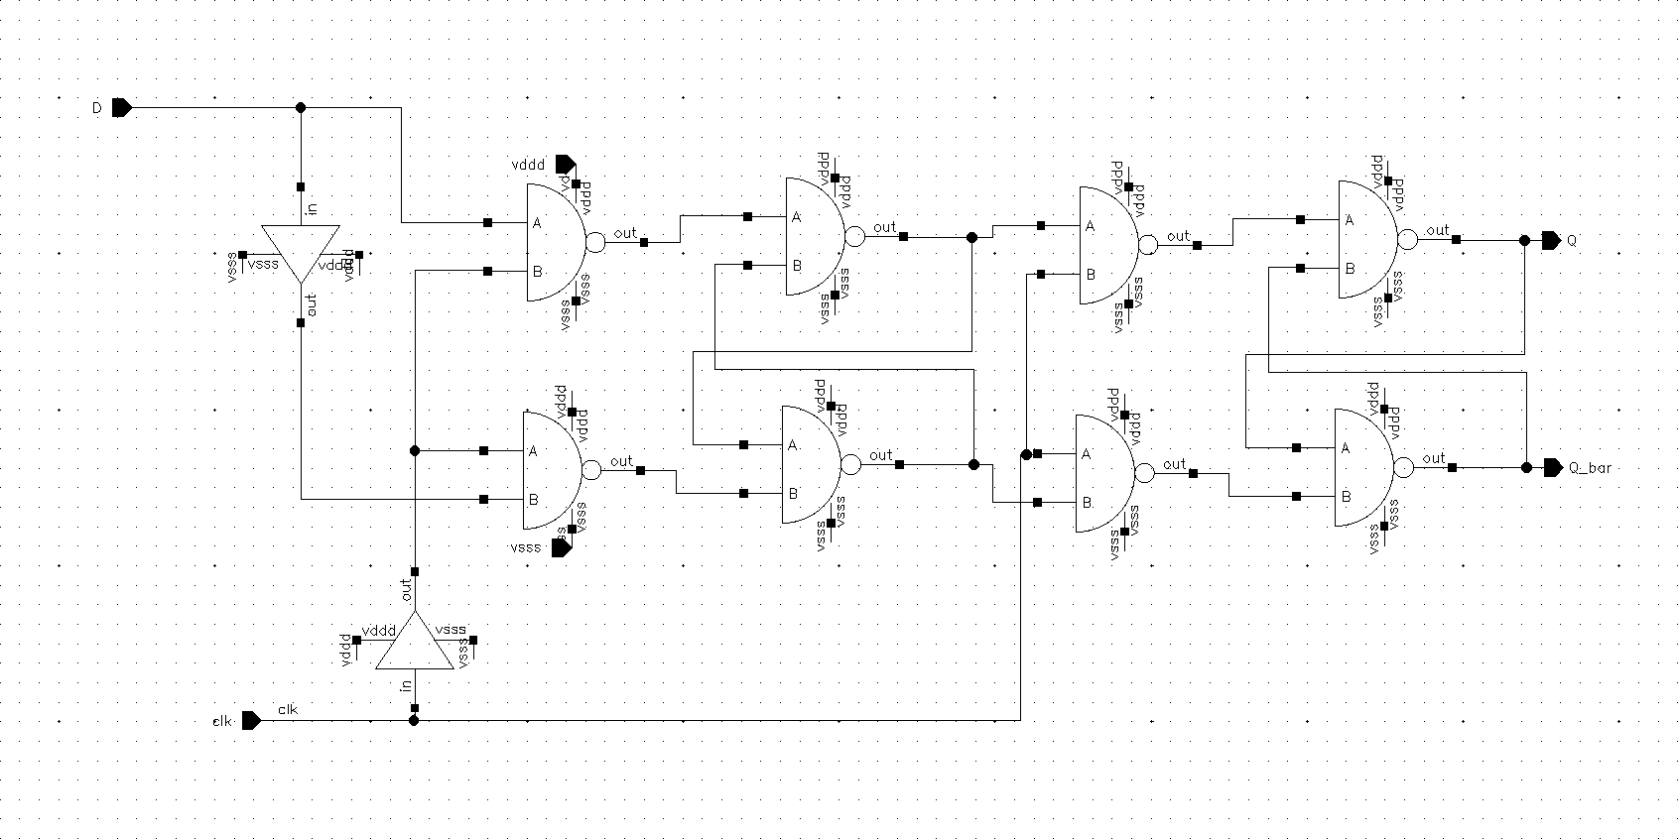
5- Divider
b) CMOS Flipflop

Slide 32
(5)
PLL System Simulations

Slide 33
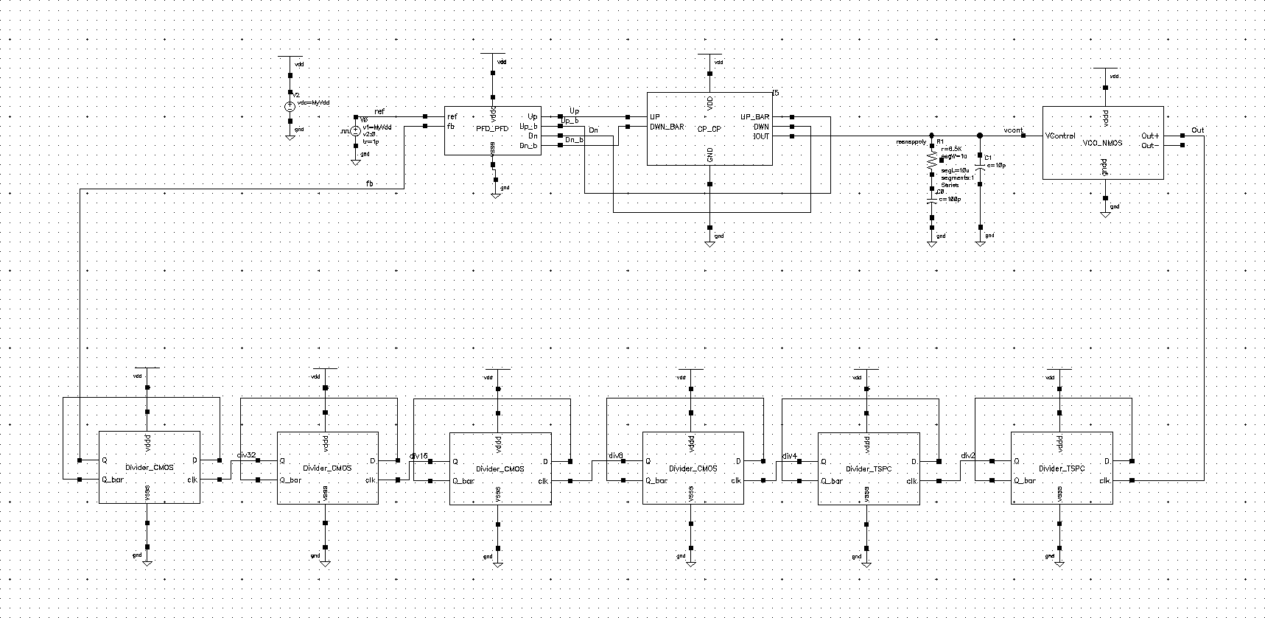
Test Bench

Slide 34
A. Using LC VCO

Slide 35
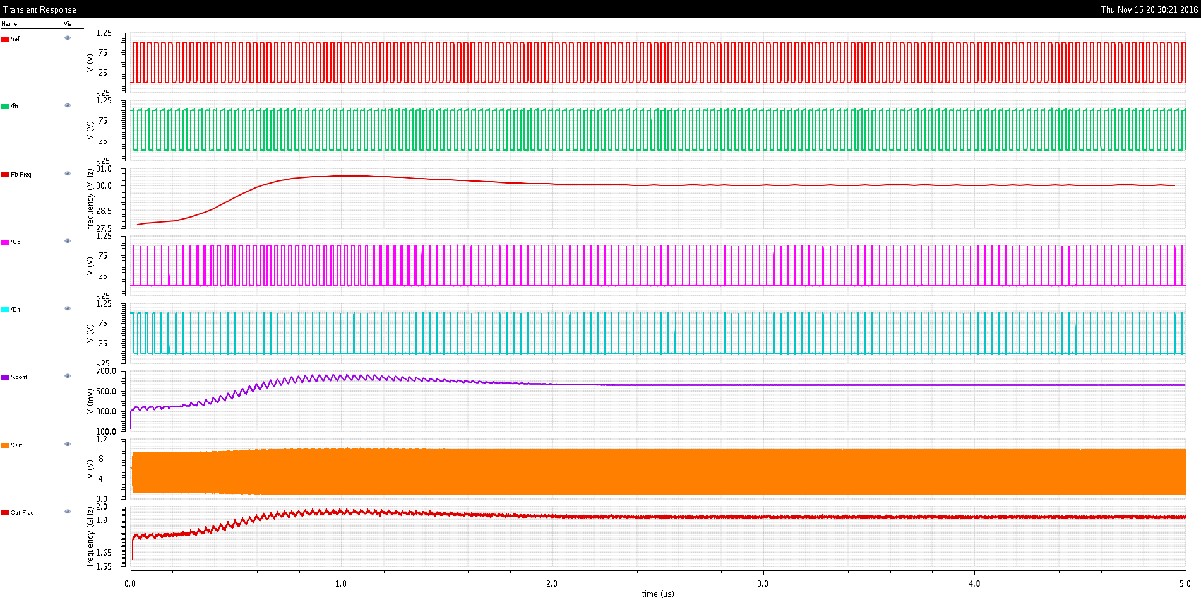
Waveforms
Ref
Fb
Freq_Fb
Up
Dn Vcontrol VCO_out
Freq_out

Slide 36
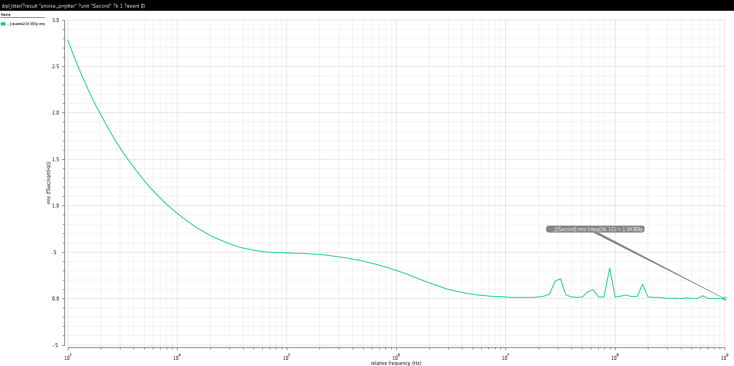
RMS Jitter
RMS Jitter
RMS Jitter = 1.5431 ps (integrated from 1KHz to 1GHz)

Slide 37
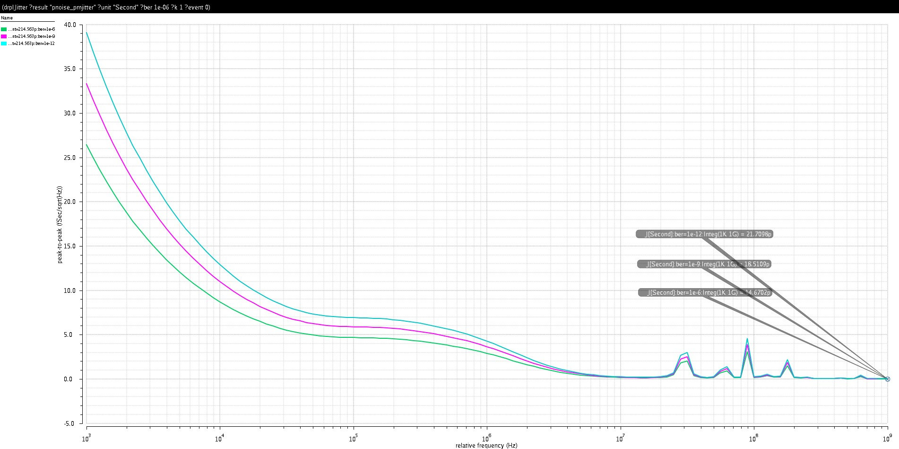
Pk-Pk Jitter
PkPk Jitter
@diff. BERs (integ. From 1K to 1G)

Slide 38
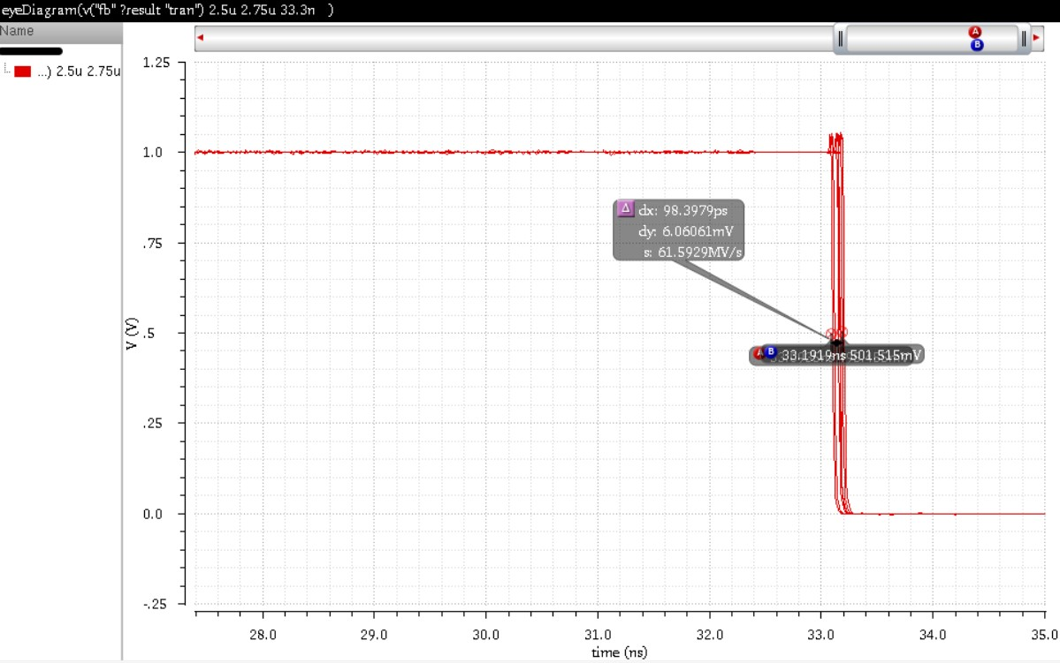
Eye Diagram Jitter

Slide 39
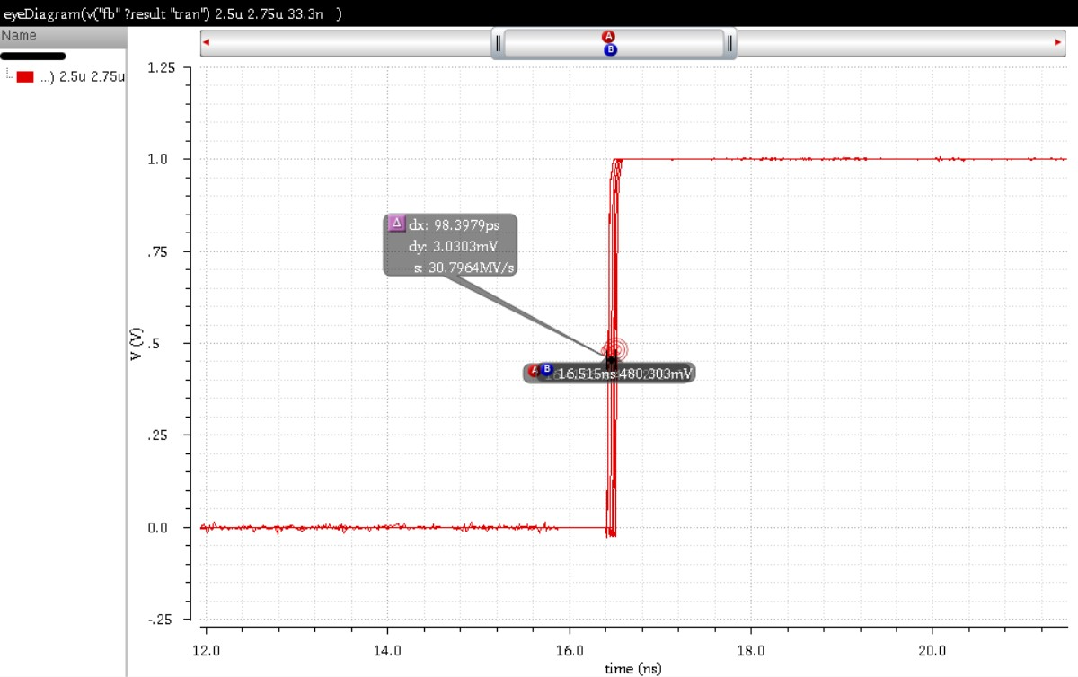
Eye Diagram Jitter

Slide 40
B. Using Current-Starved Ring
VCO

Slide 41
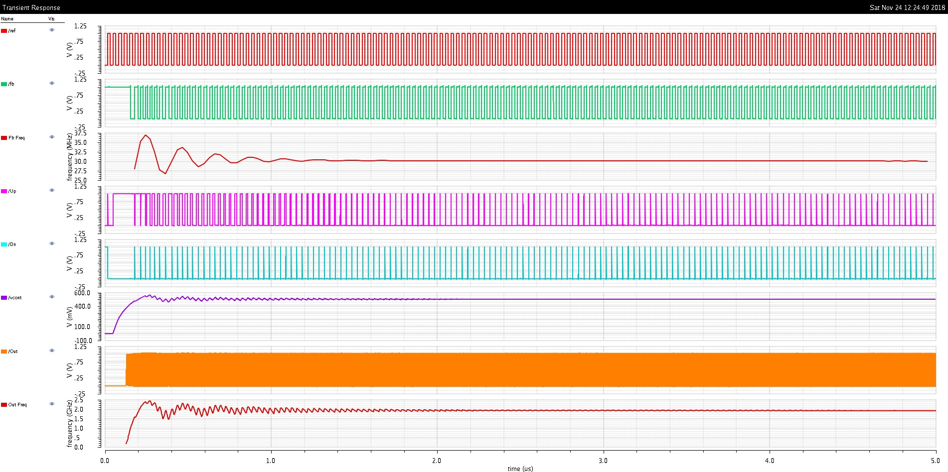
Waveforms
Ref
Fb
Freq_Fb
Up
Dn Vcontrol VCO_out
Freq_out

Slide 42
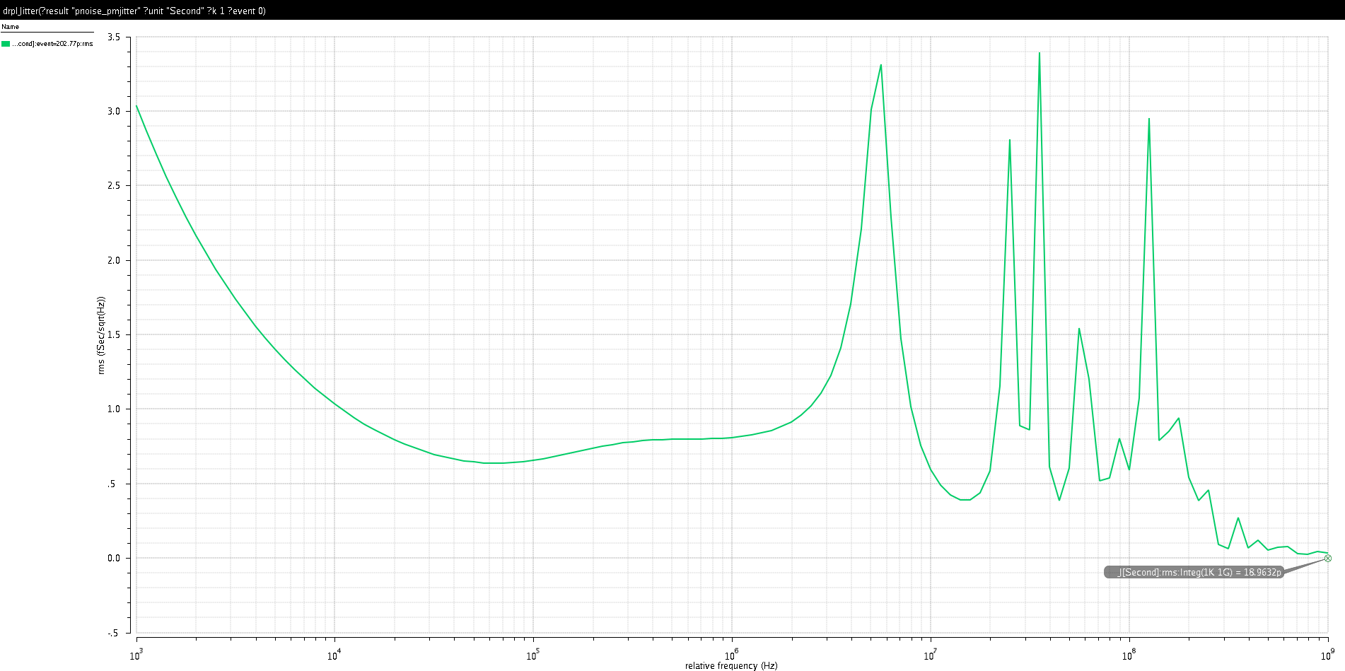
RMS Jitter
RMS Jitter
RMS Jitter = 18.9632 ps (integrated from 1KHz to 1GHz)

Slide 43
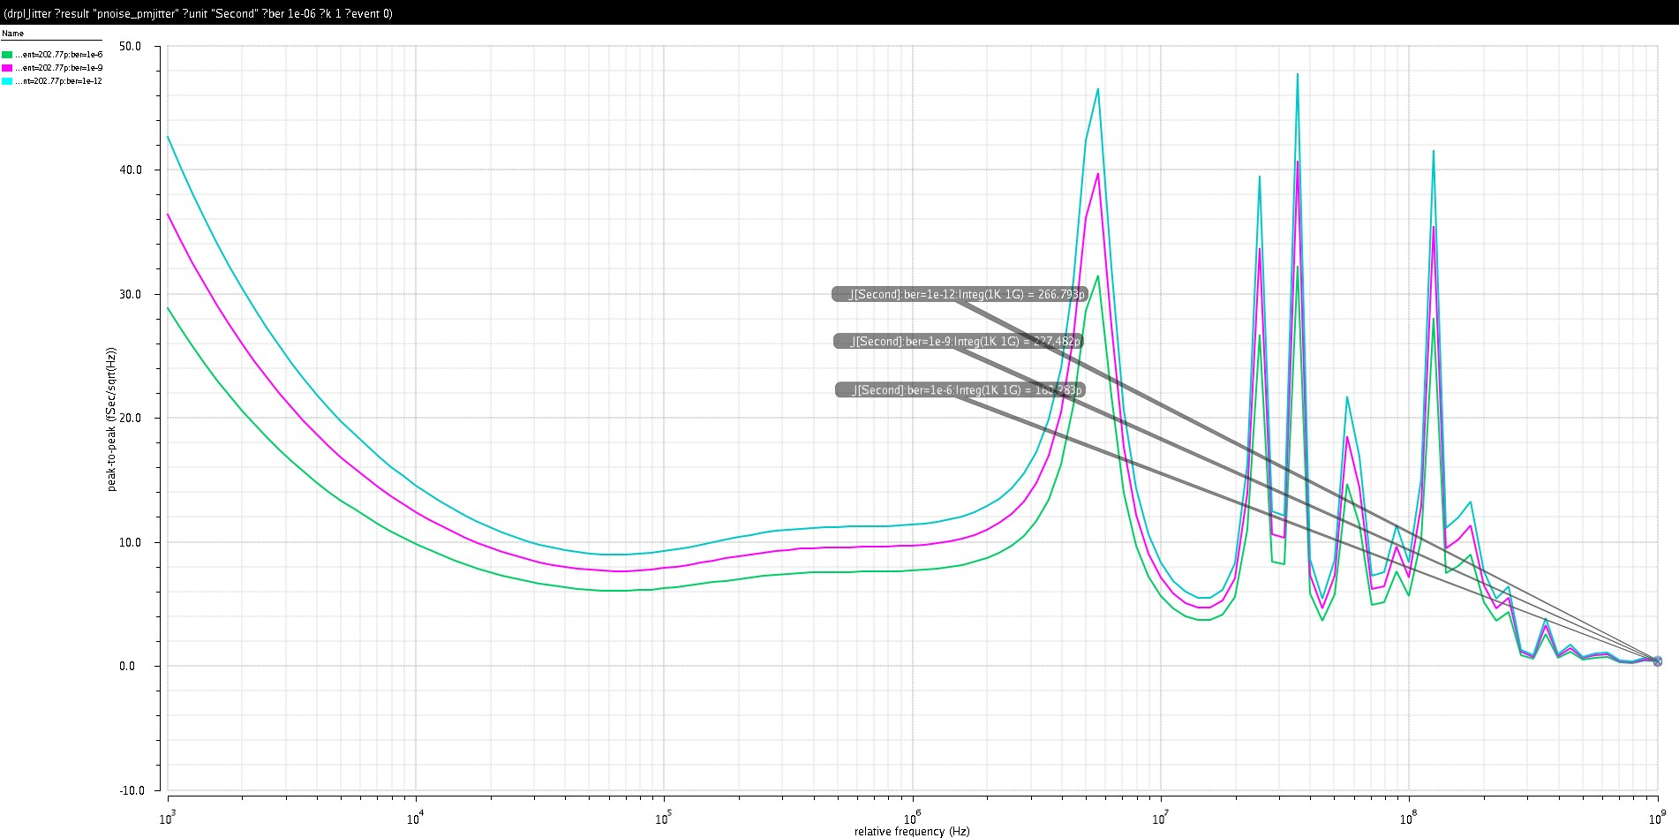
Pk-Pk Jitter
PkPk Jitter
@diff. BERs (integ. From 1K to 1G)

Slide 44
Comparison
 | PLL with LC VCO | PLL with Ring VCO
Tuning Range | 1.68 GHz – 2.02 GHz | 0.5 GHz – 3 GHz
Locking Time | < 2.1 us | < 1.5 us
P dissipation | 1.26175 mW | 1.21701 mW
RMS Jitter | 1.5421 ps | 18.9632 ps
FOM | -235.23 dB | -213.59 dB

Slide 45
(6)
Corner Simulations

Slide 46
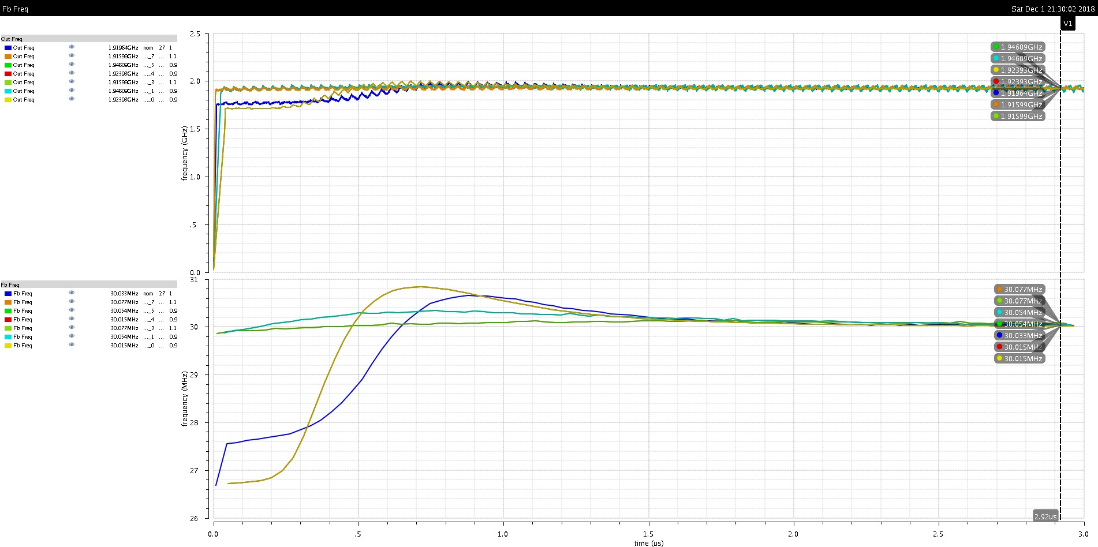
All Corners
Freq_out
Freq_Fb

Slide 47
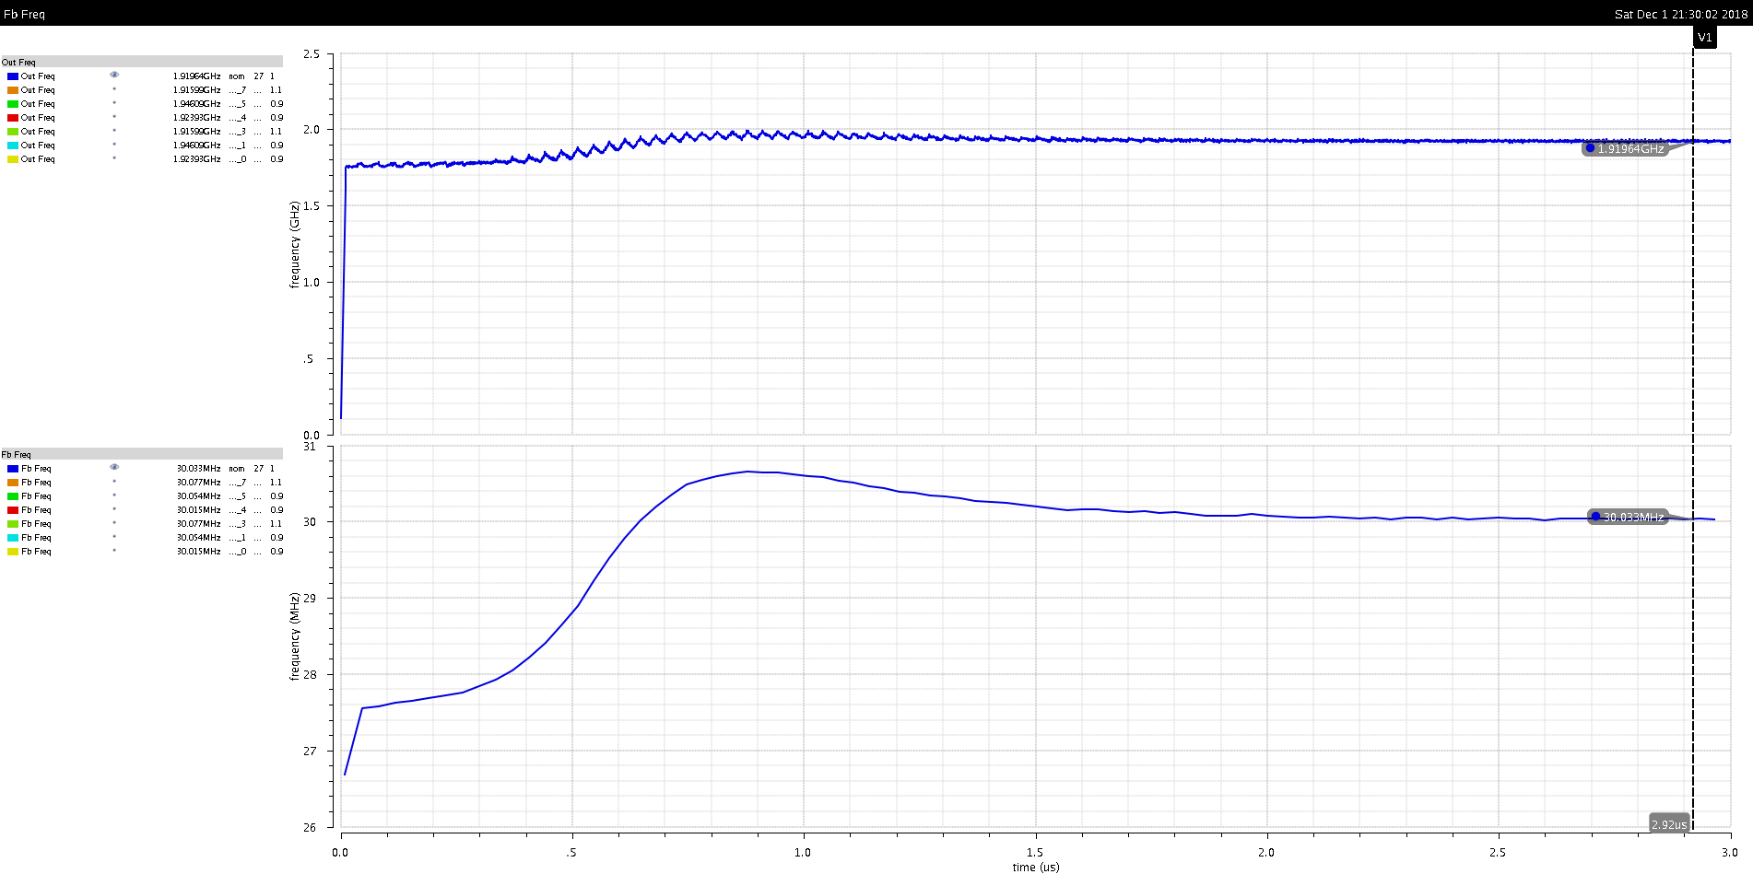
Nominal TT, 27°, 1 VDD
Freq_out
Freq_Fb

Slide 48
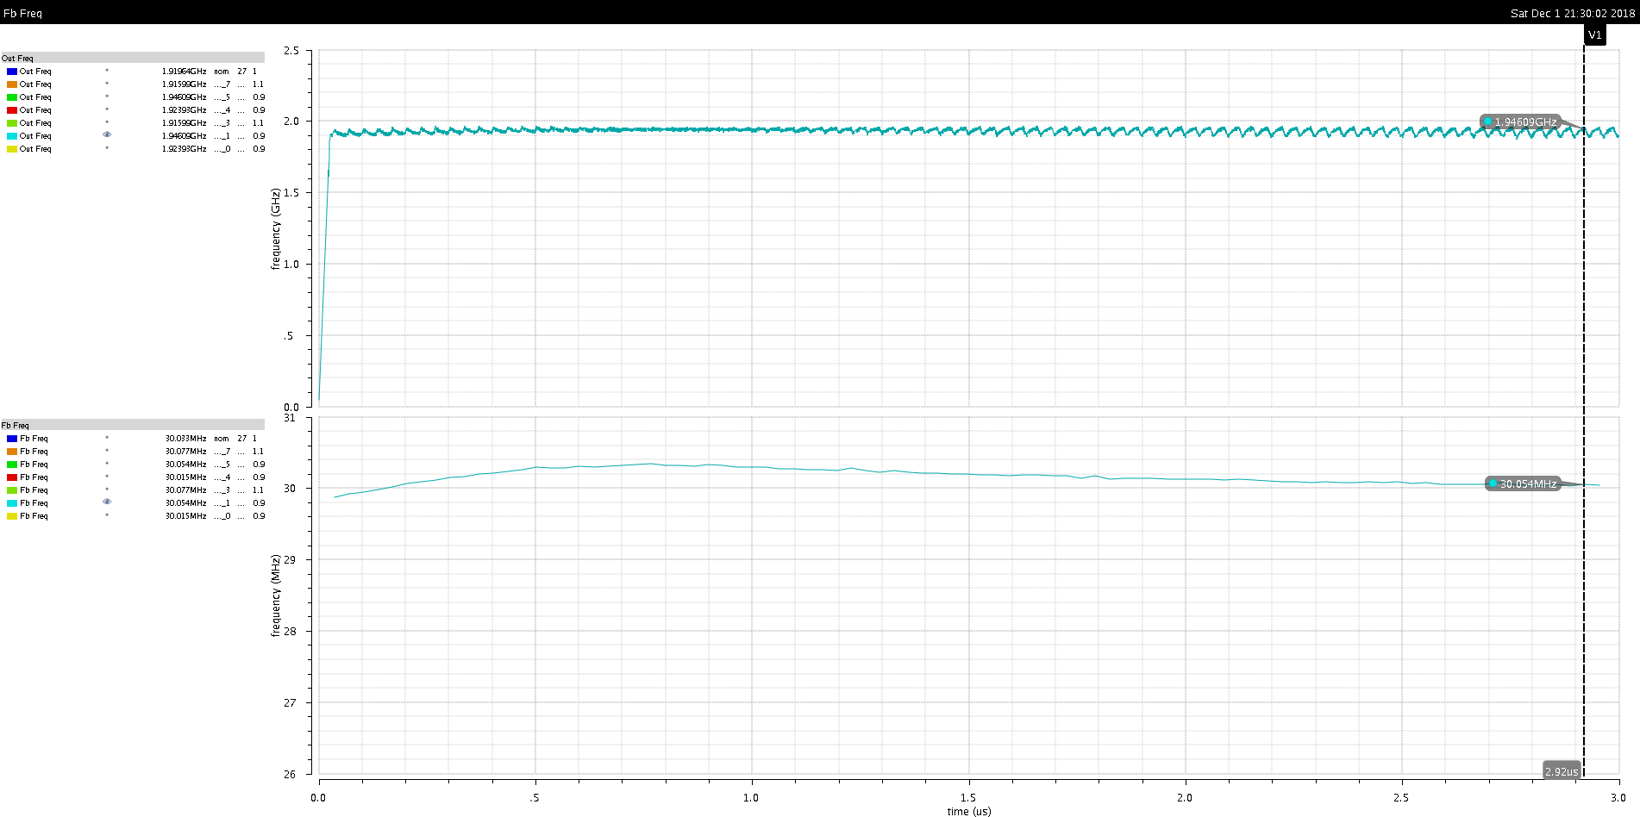
FF, 125°, 0.9 VDD
Freq_out
Freq_Fb

Slide 49
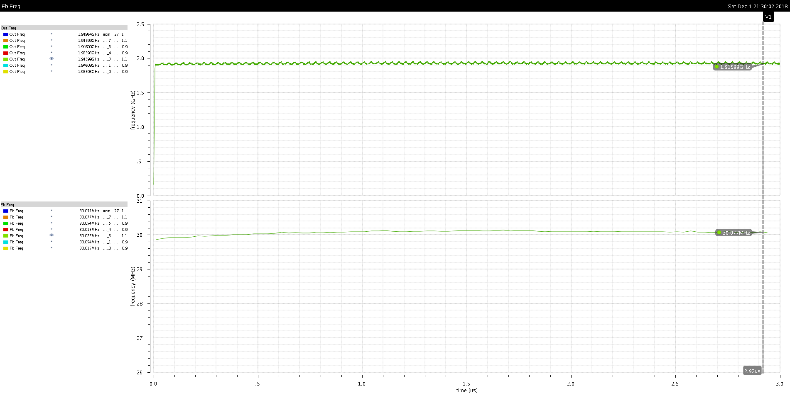
FF, 125°, 1.1 VDD
Freq_out
Freq_Fb

Slide 50
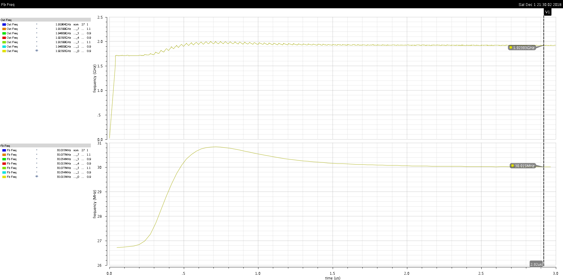
FF, -40°, 0.9 VDD
Freq_out
Freq_Fb

Slide 51
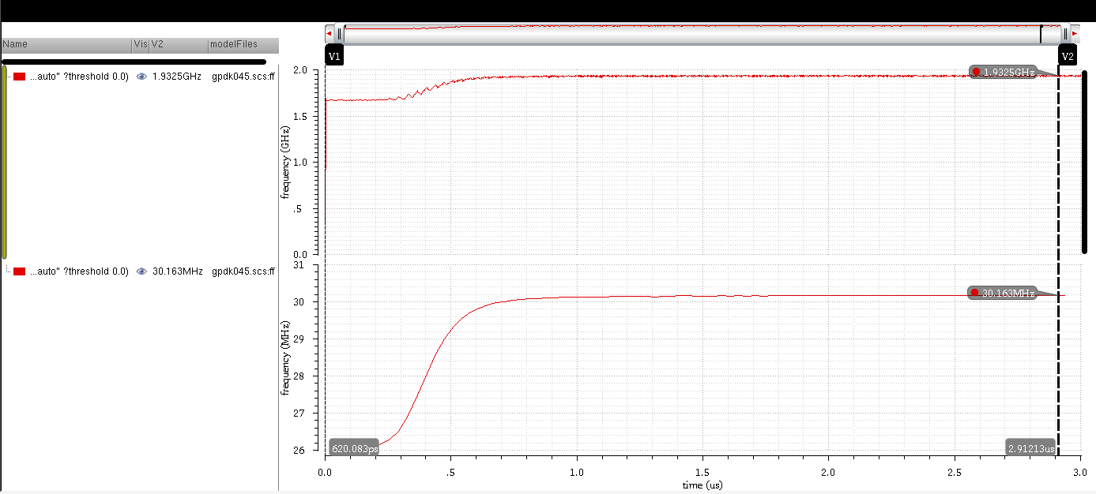
FF, -40°, 1.1 VDD
Freq_out
Freq_Fb

Slide 52
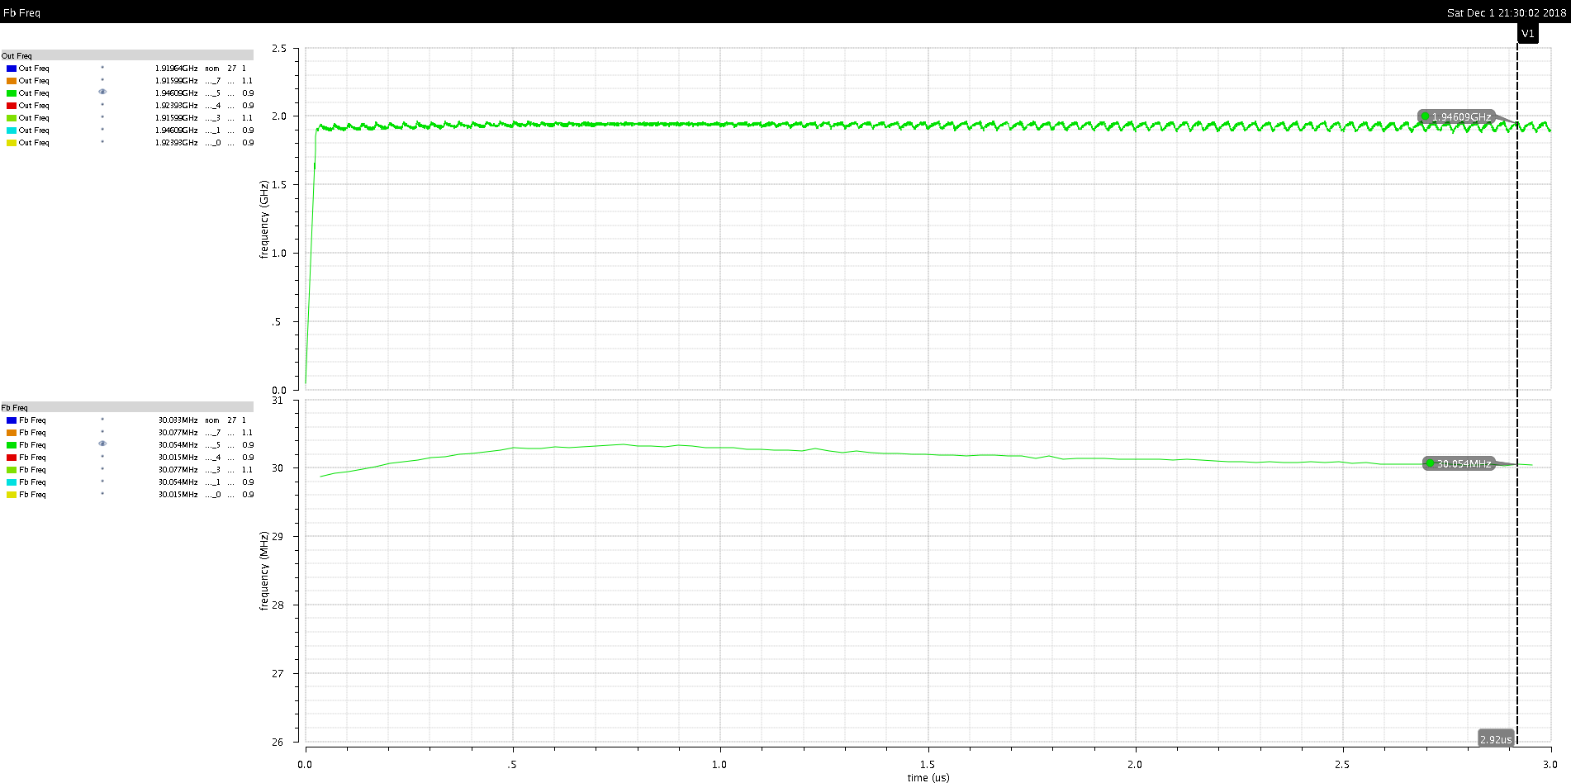
SS, 125°, 0.9 VDD
Freq_out
Freq_Fb

Slide 53
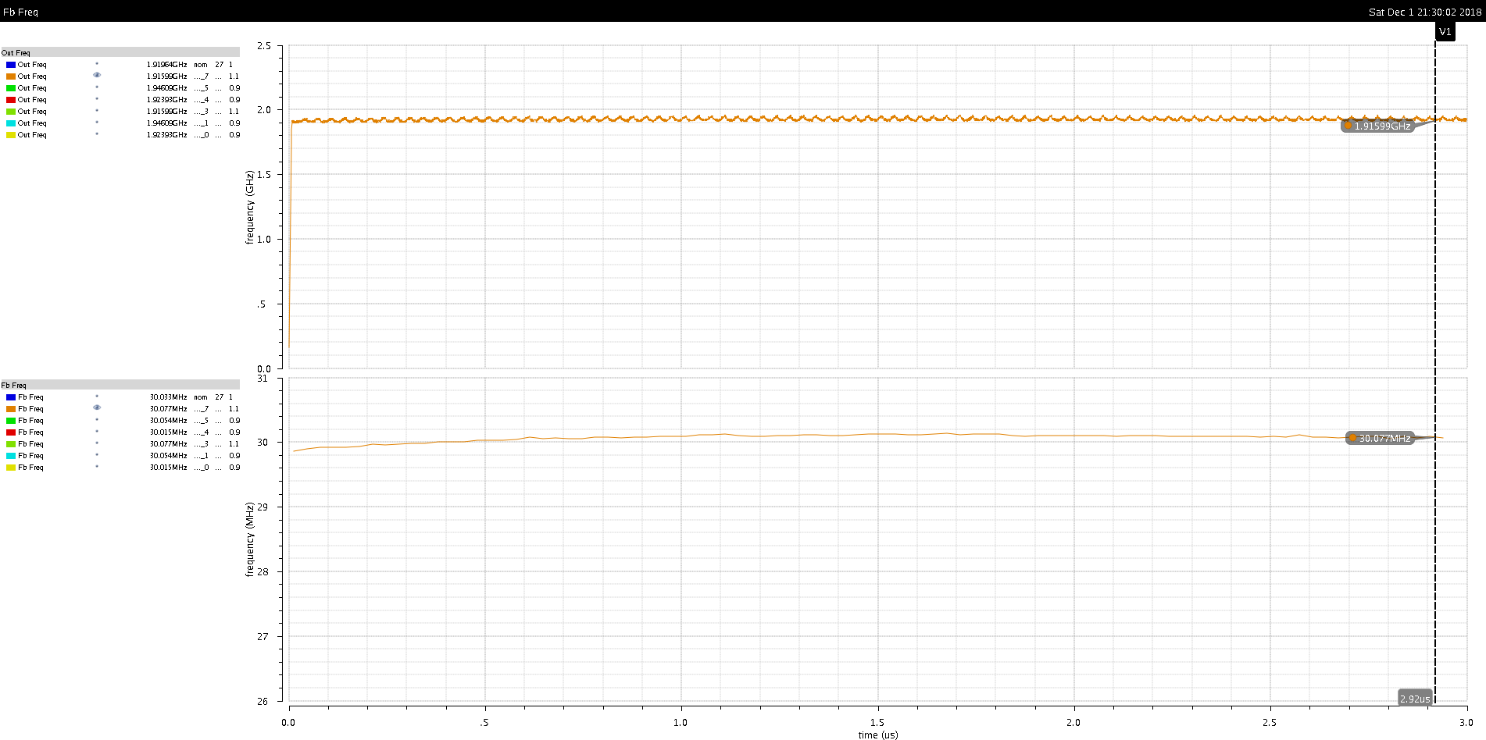
SS, 125°, 1.1 VDD
Freq_out
Freq_Fb

Slide 54
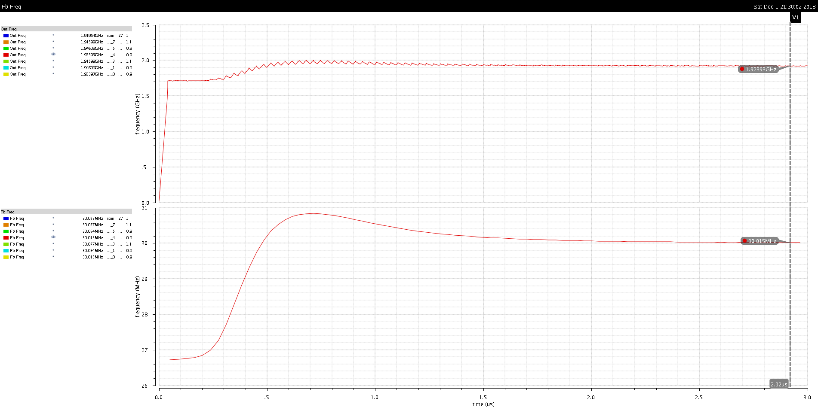
SS, -40°, 0.9 VDD
Freq_out
Freq_Fb

Slide 55
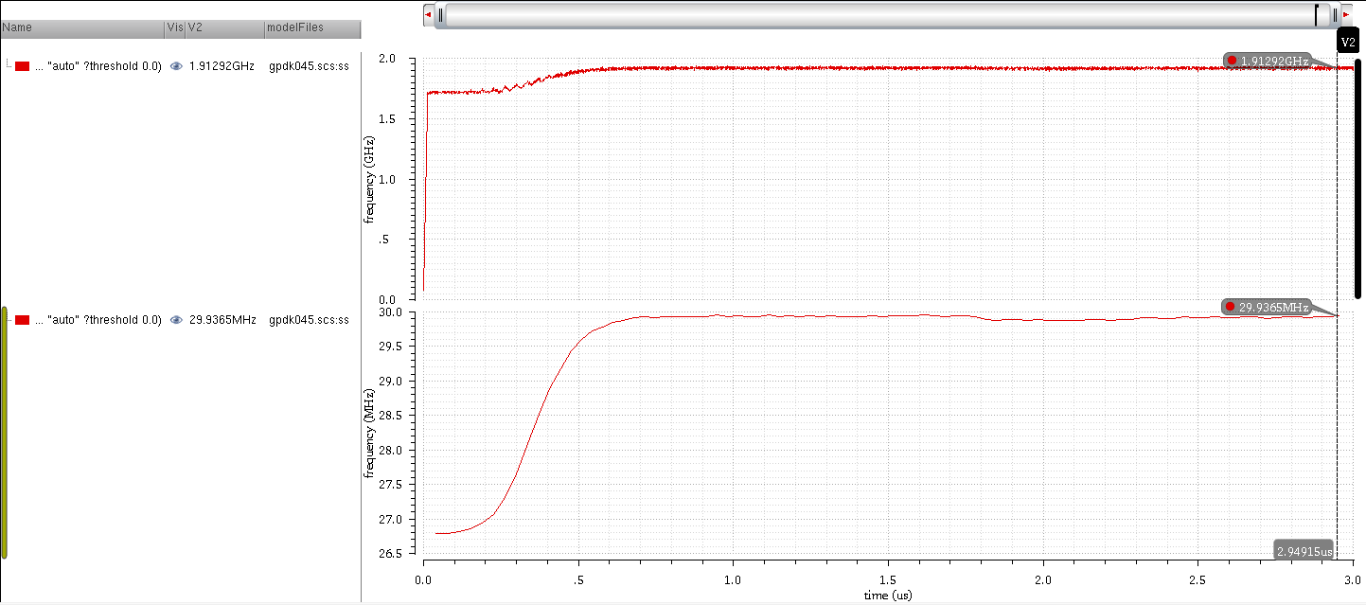
SS, -40°, 1.1 VDD
Freq_out
Freq_Fb

Slide 56
(7) Summary
Our work shows a comparison between a CP-PLL using a Ring VCO & another using an LC VCO:
The Ring VCO gives a higher KVCO, which affects the PLL’s
stability & gives a higher jitter than that in the LC VCO.
Using the LC VCO, we were able to achieve a low RMS jitter with a reasonable power dissipation, achieving the required FOM.
In our corners’ analysis:
The range of the output frequency after the PLL locks is between 1.916 GHz & 1.946 GHz.
The range of the feedback frequency after the PLL locks is between 30.015 MHz & 30.077 MHz.

